Slide 1
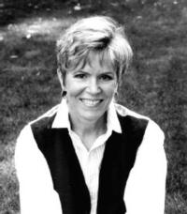
Barbara Park
By: Gianna Hanson

Slide 2
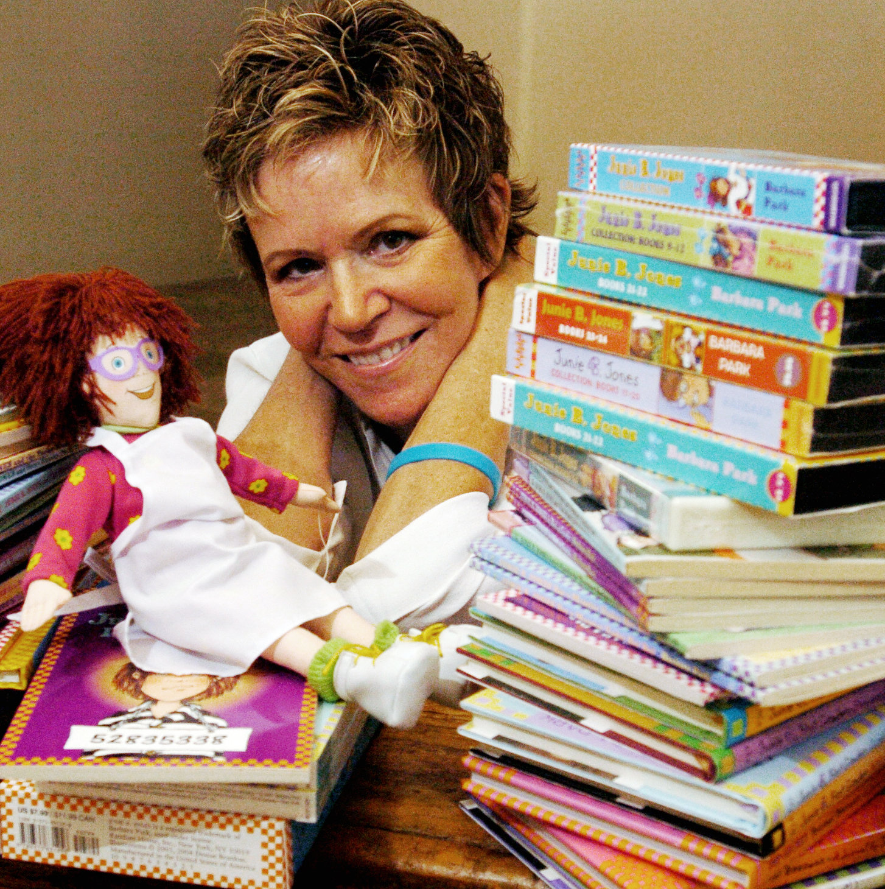
About the author
Barbara Park was born on April 21, 1947. She died November 15, 2013. She had 2 children. Their names were David and Steven. Barbara Park spent most of her life in Arizona. She had a husband named Richard. She wrote children books. She also won awards for the best children's books. 55 million were sent to people all over North America.

Slide 3


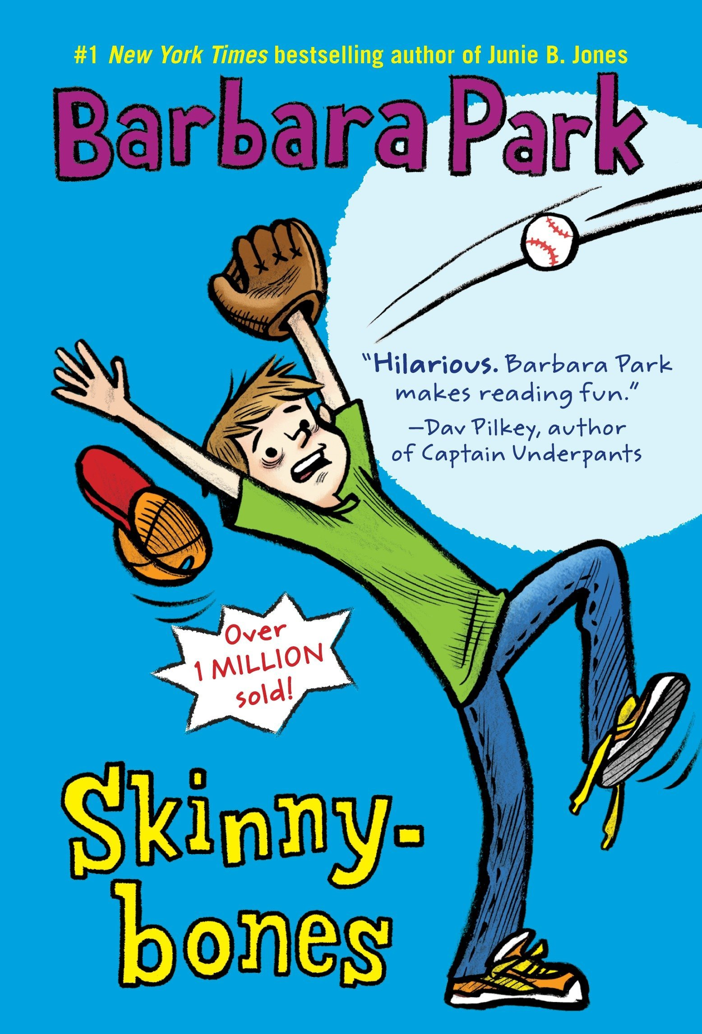
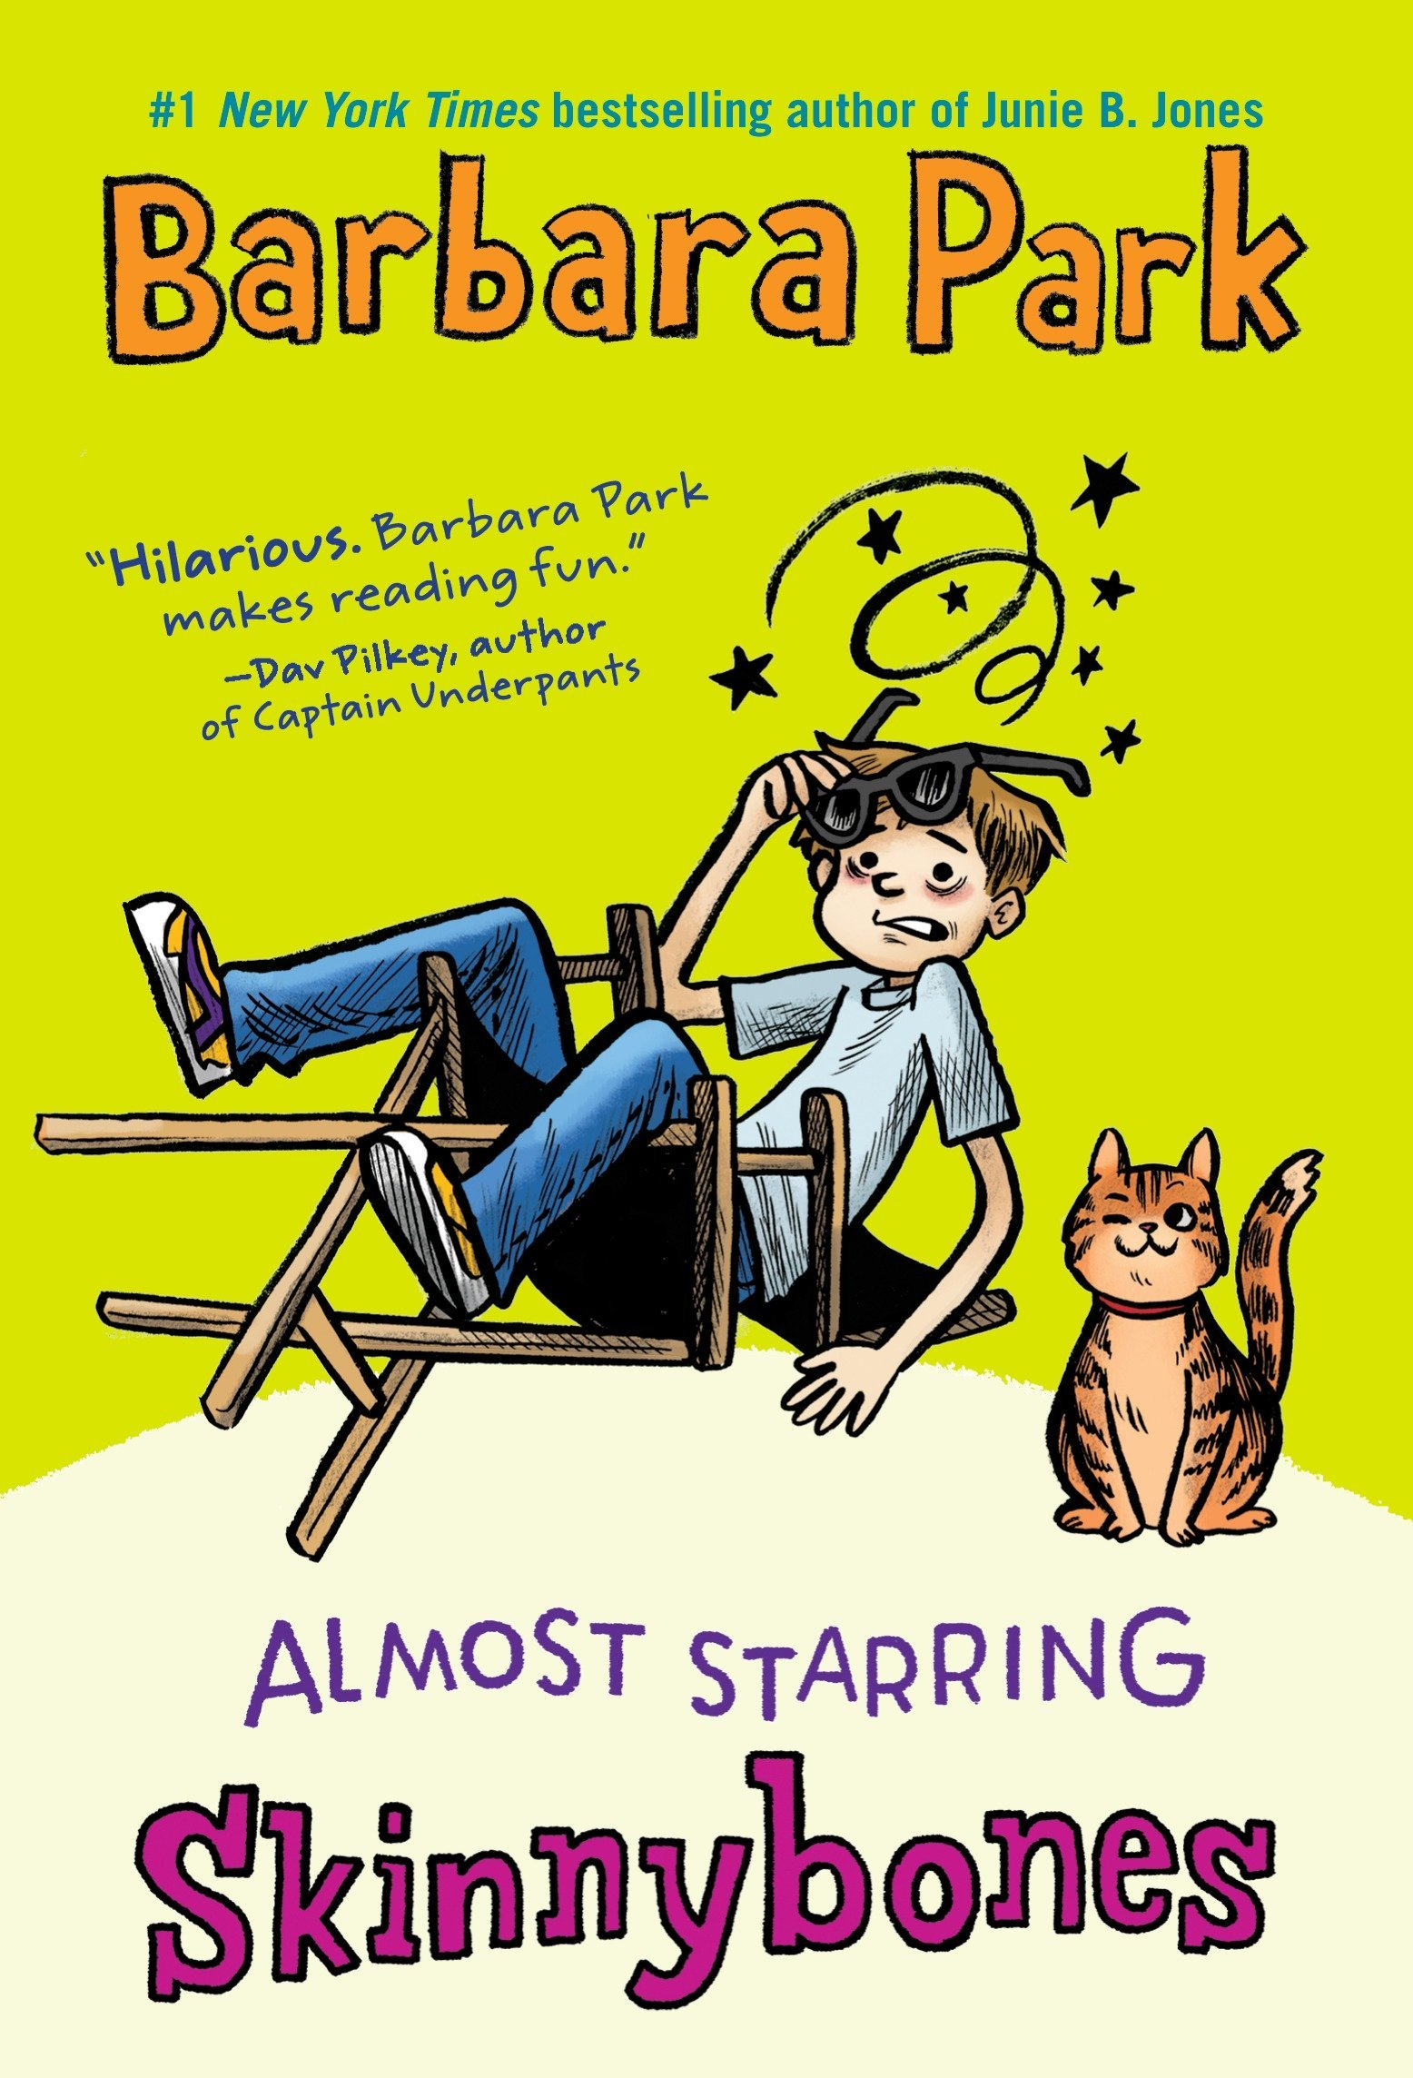

Books written by the author
Barbara Park wrote over 50 books. Barbara wrote Skinny Bones and Junie B. Jones. There were 28 books in Junie B. Jones. Only 2 books in Skinny bones. They were both children's books. Junie B. Jones was a 7 year old who would always write in her diary. Skinny Bones was a baseball player and people would make fun of his mouth.

Slide 4

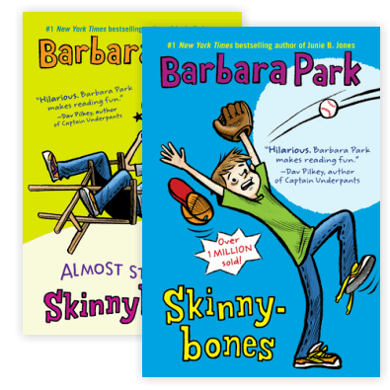
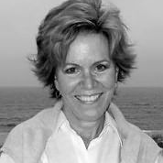
Why I recommend this author
I recommend Barbara Park because she won many awards. When you start reading her books you will start reading more, more, and more. They are kid books. So, any age can read them.

Slide 5

Fun facts about the author
Barbara Park won more than 40 awards. Barbara was born in Mount Holly, New Jersey. She spent most of her life in Arizona. Now she 66 years old. Barbara Park had two dogs. Most of the best selling books were in New York. Her favorite series was Junie B. Jones.

