Slide 1

Lauren Tarshis
By: Rhys

Slide 2
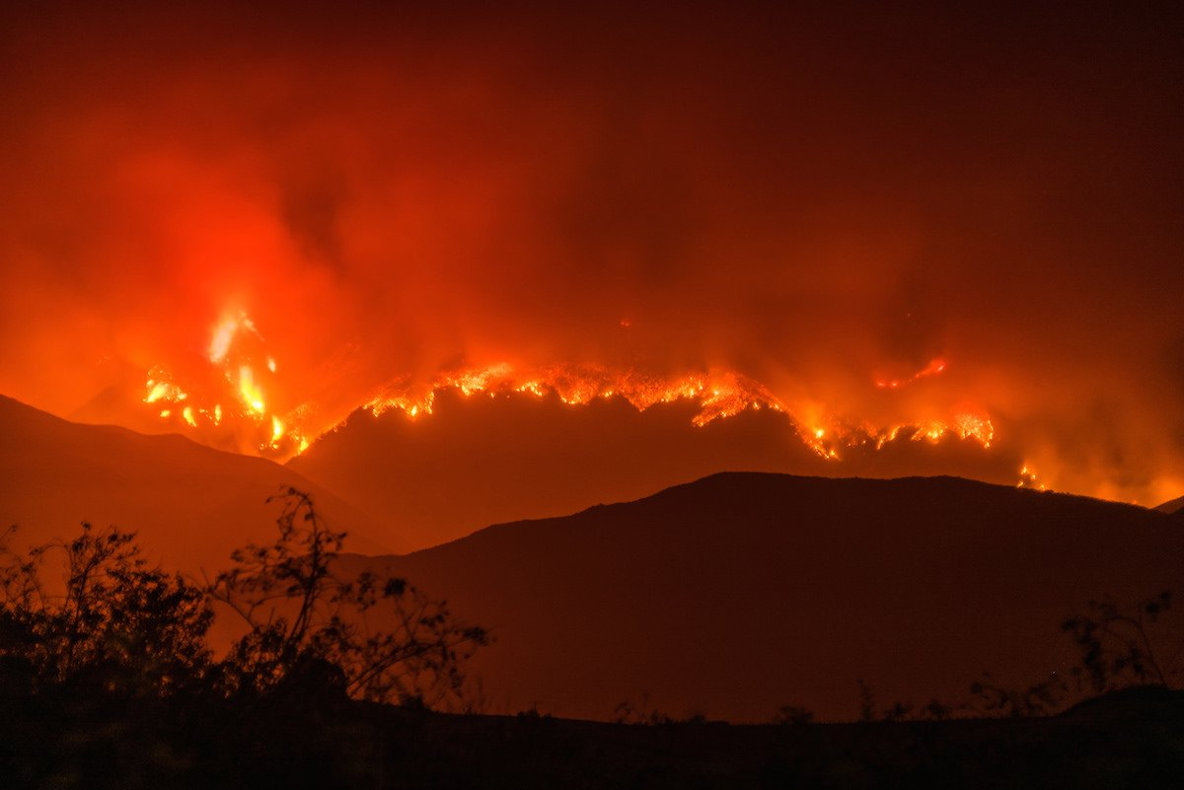
About the Author
Lauren Tarshis is a who start writer. She started her career as a writer making ''I surived '' books in 2020. A whopping 20 Books so far.
I like I survived''. It’s a good series and I like how she talks about each Thing that happened like ''I survived the 2020 California wild fires.

Slide 3
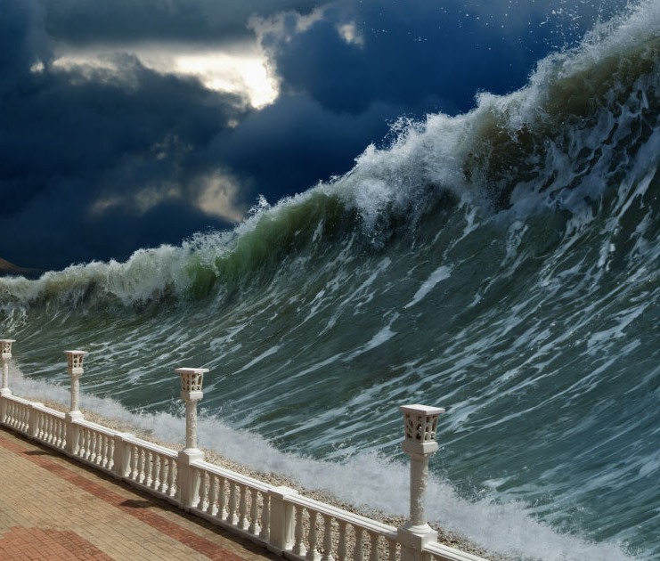
Books written by the Author
Some books written by this author are. I surived the attack of hidesburg in 1937,"Isurvid the Japaness tsunami
This Photo by Unknown author is licensed under CC BY-NC.

Slide 4
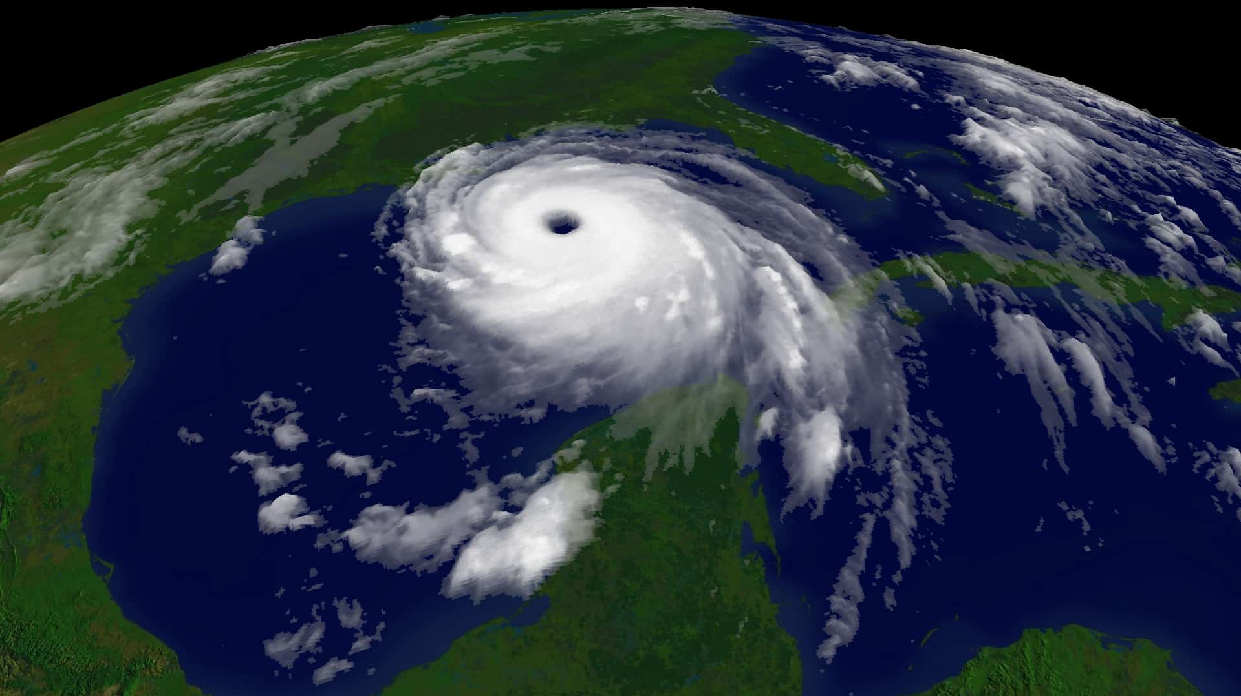
Why I recommend this Author
I recomand this author because she is a good book writter because I like the type of books she makes and how she knows what time all the disasters
This Photo by Unknown author is licensed under CC BY-NC.

Slide 5

Fun facts
In edit to writing books she is a SVP editor in chief and publisher of the class room Magazine division at scholastic Inc.
This Photo by Unknown author is licensed under CC BY.

